Slide 1

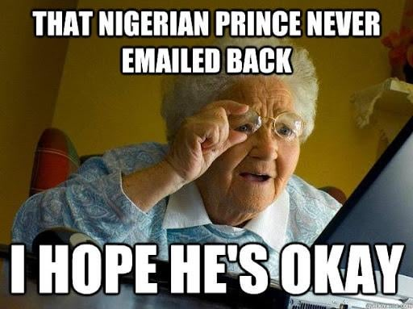
The Nigerian Prince Never Left:
Cybersecurity in the Modern Era and the Cost of One Click

Slide 2
Introductions
Microsoft Windows [Version 10.0.19044.4291]
(c) Microsoft Corporation. All rights reserved.
C:\> whoami

Slide 3
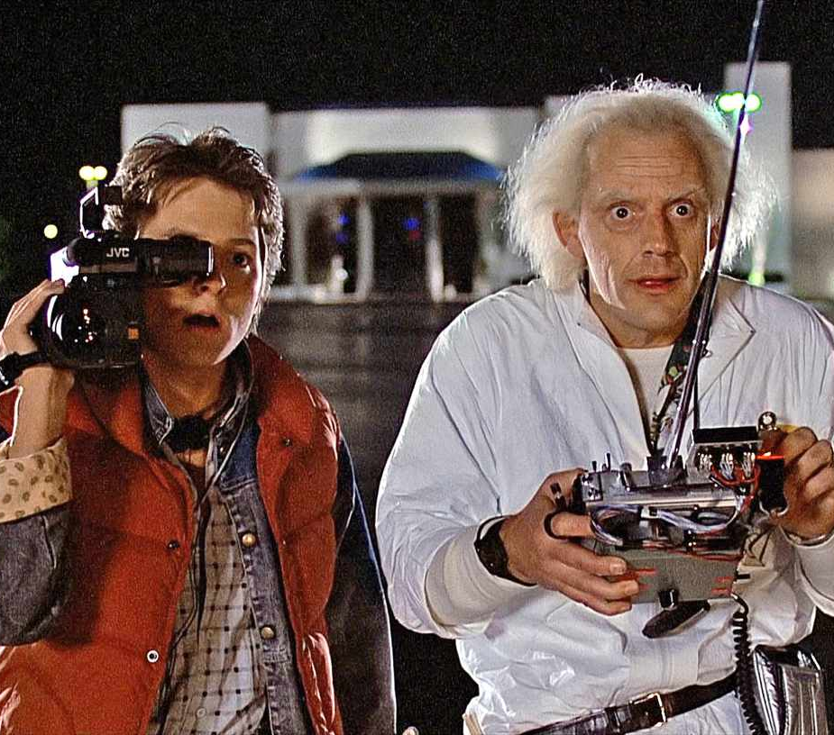




Let’s hop into our DeLorean and go back to where it all began

Slide 4
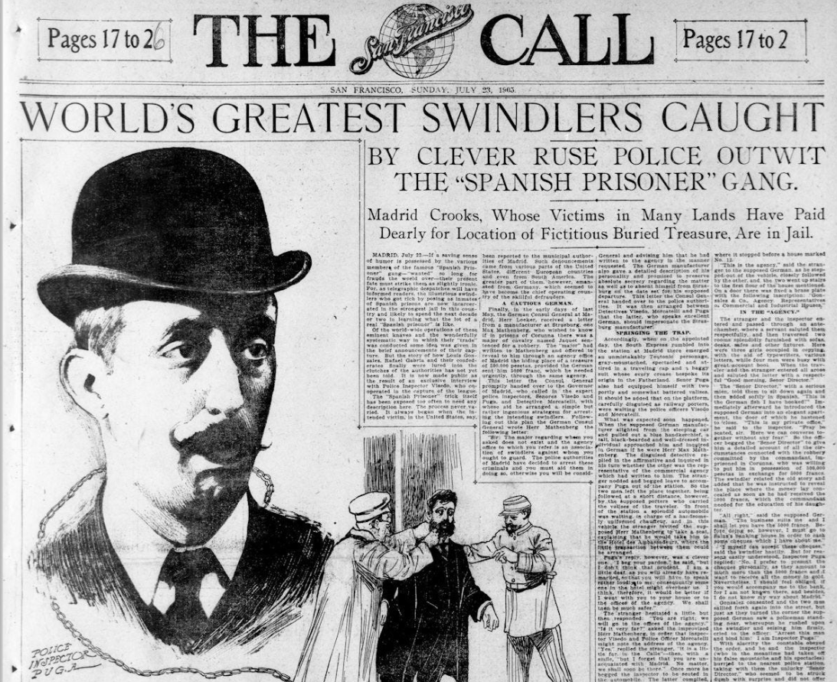
The 1800s and The Spanish Prisoner Letter Scam
Notes:
The "Spanish Prisoner" letter is a classic 19th-century confidence trick (or advance-fee fraud) where a scammer poses as a wealthy, unjustly imprisoned Spaniard. The letter asks the recipient to help secure their release in exchange for a portion of a massive hidden fortune. It is considered a precursor to modern Nigerian prince scams.

Slide 5
Hopping back into the DeLorean and going 200 years into the future!

Slide 6
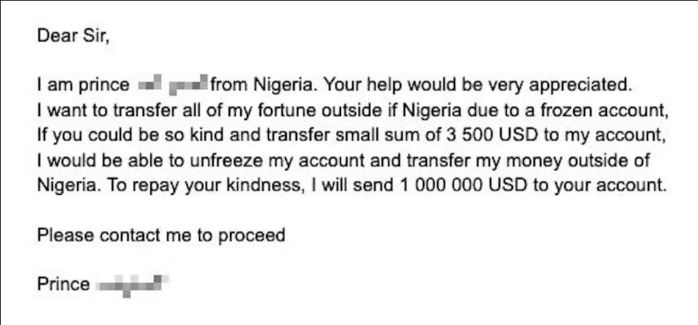
Roughly Two hundred years Later...Enter in the Nigerian Prince Scam!

Slide 7
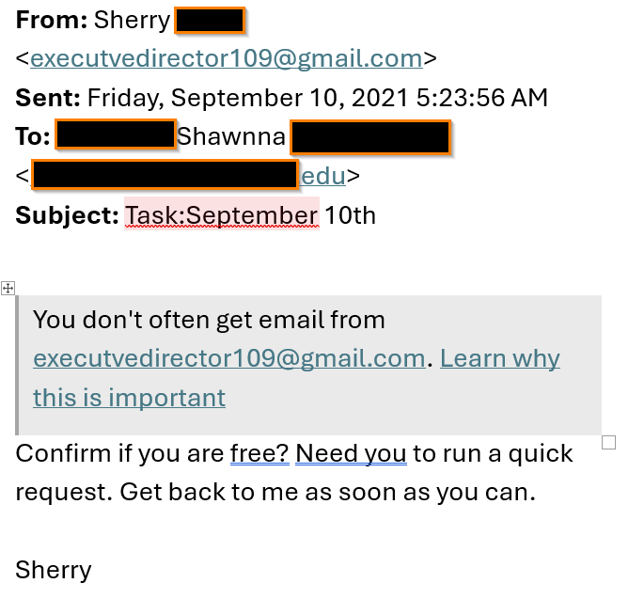
20 years later...
Urgency Does NOT always Equal Legitimacy!

Slide 8
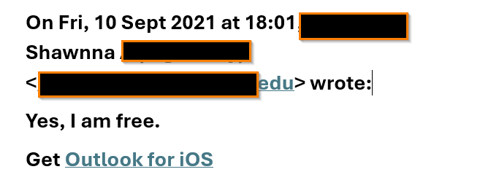

Slide 9
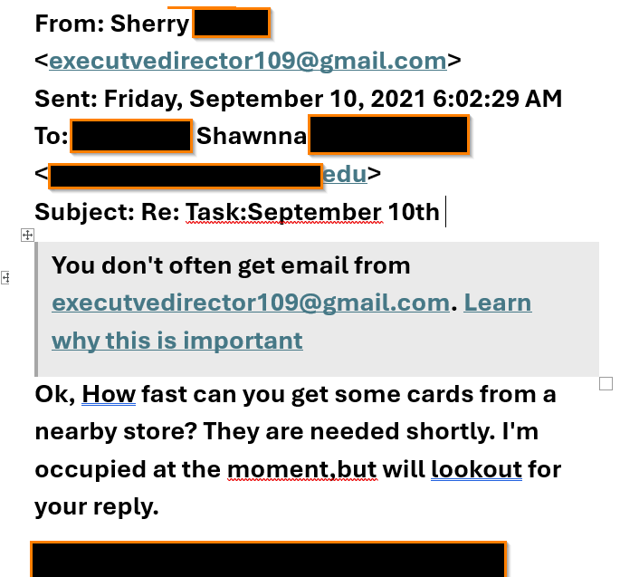

Slide 10
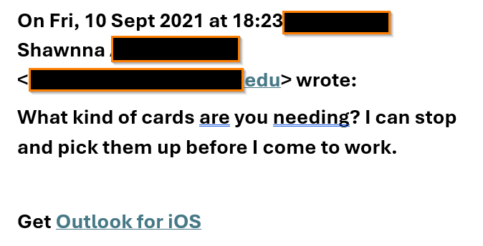

Slide 11
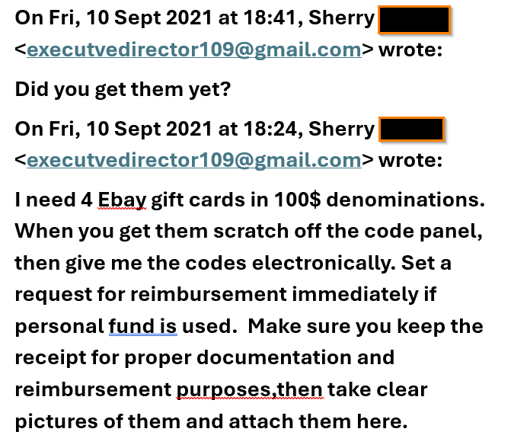

Slide 12

The Takeaway – Don't Respond via email!
Call your supervisor or coworker to safely determine if they are trying to reach you!

Slide 13
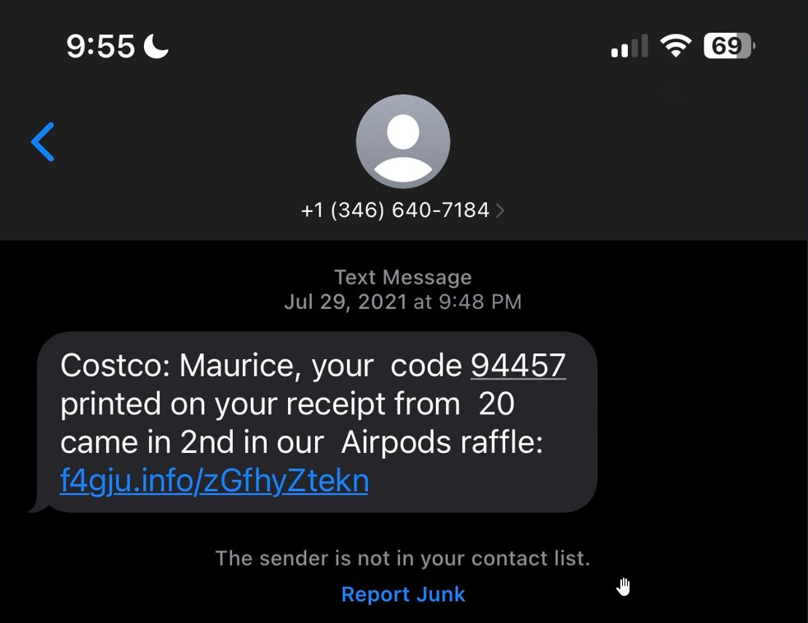
It only gets worse...
We also now receive electronic text communication via our Phones!
Same scam, different vehicle of transmission

Slide 14
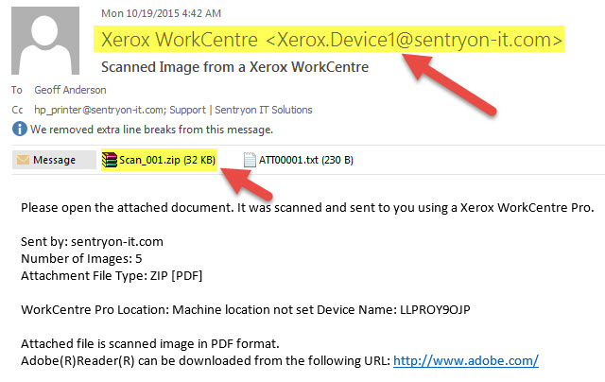
and worse... :)
Ransomware

Slide 15
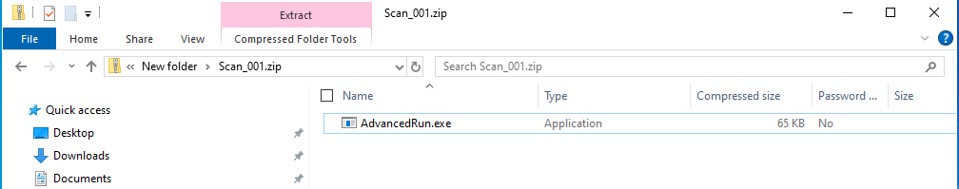
Your scanned document is ready!

Slide 16
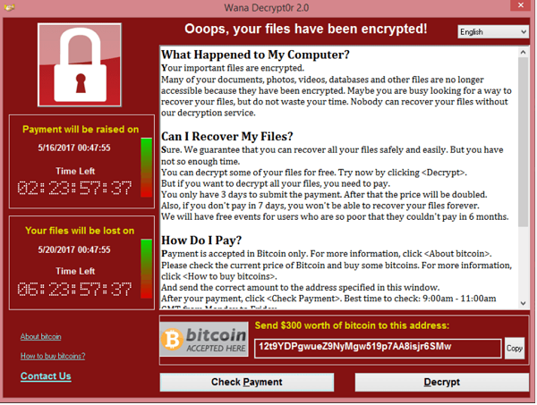

Slide 17
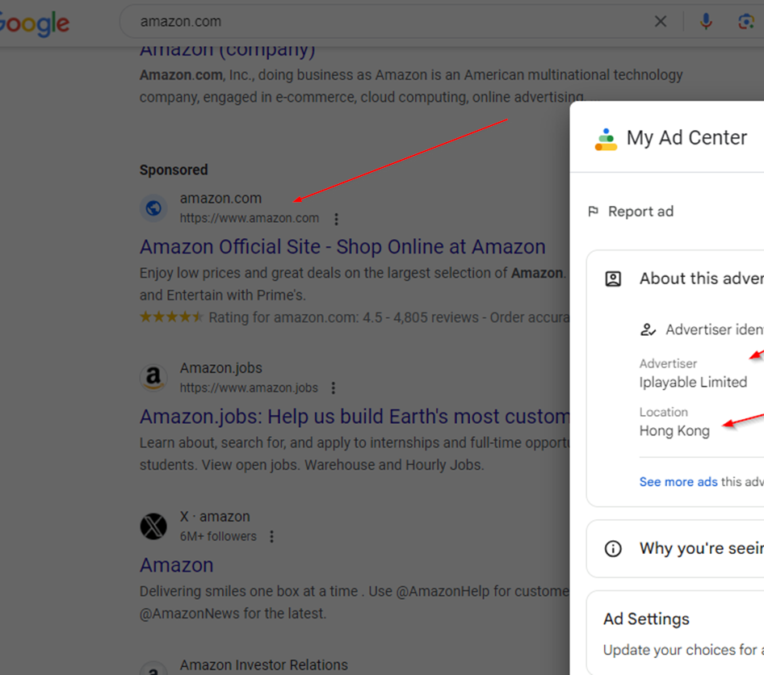
Malvertising / Domain Squatting

Slide 18
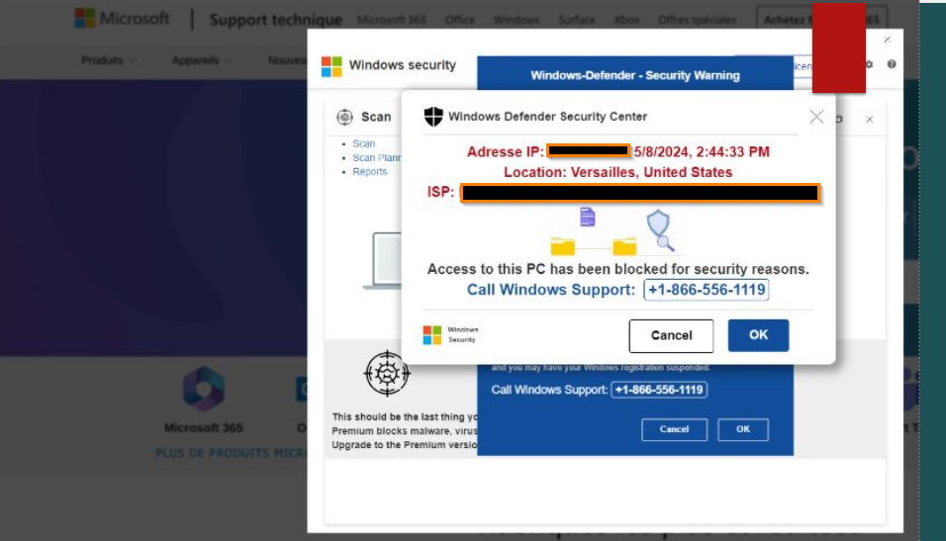

Slide 19

Malvertising / Domain Squatting Cont...

Slide 20


Slide 21


Slide 22

Malvertising / Domain Squatting Cont...

Slide 23
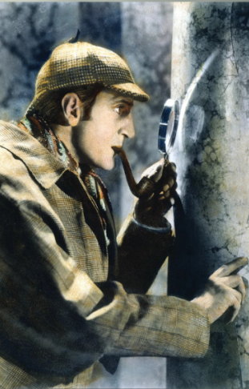
Put on your detective hat

Slide 24
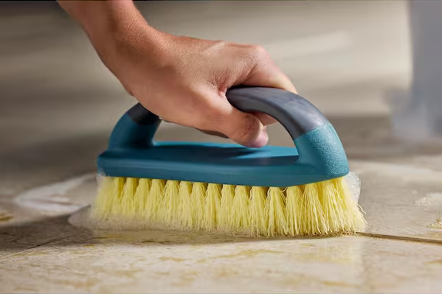
First, let's scrub out all personal and company specific identifiers

Slide 25
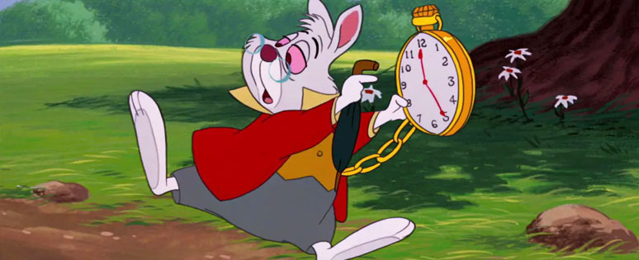
DEMO TIME!

Slide 26
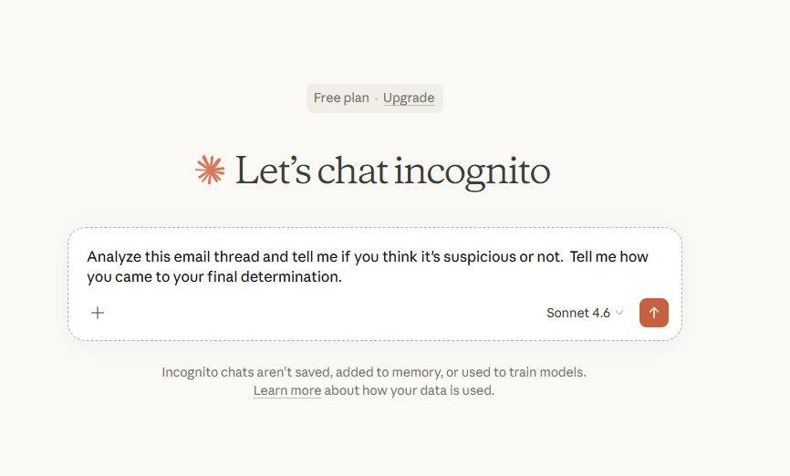
Now, let's analyze this using AI!
https://claude.ai/share/ef2b3073-6364-442b-b930-90dae6485268

Slide 27
Put on your detective hat – part 2

Slide 28
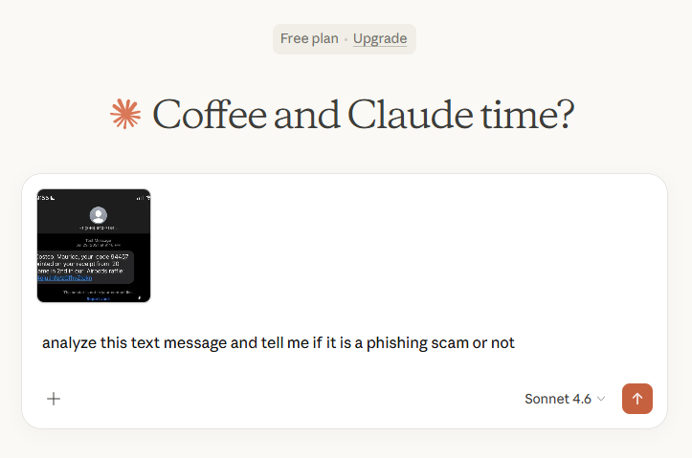
Put on your detective hat – part 3
https://claude.ai/share/ae6f9768-b8ad-4c0b-92a2-aaa43ba2939d

Slide 29
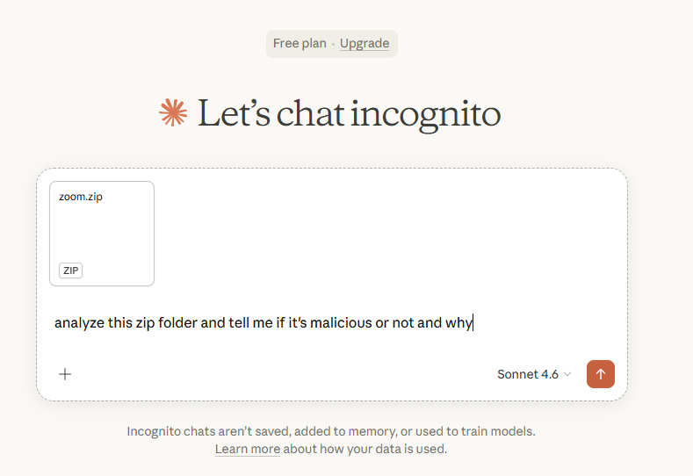
Scrub the Text Message and Aanlyze with AI! DEMO
https://claude.ai/share/03398cbd-868c-4ef8-b77b-efb1154e9297

Slide 30

QUESTIONS?

