Slide 1


Slide 2


UK Institutional Awarding Landscape
4 FT staff members to administer University CORE scholarship and approx. 250 endowed/gift scholarship programs
  ~ 24,000 FTF academic/competitive offers at $196 million
  ~ 8,300 FTF William C. Parker offers at $61 million
  ~ 126 FTF Legacy Tuition Program offers at $1.1 million
In process of centralizing college/departmental scholarships
  Increase number of endowed/gift scholarship programs administered by our office to approx. 1500
  4-5 new scholarship coordinators to handle increased workload

Slide 3
Awarding Methodology – Merit-based
General university scholarships are primarily merit-based and awarded according to established criteria:
  Academic/Competitive – Residency, test-optional (GPA only) or traditional criteria (GPA and test score)
    $2,500-$5,000 residential; $5,000-$12,500 nonresidential
    Competitive: full-tuition scholarships
  Parker – GPA and AS Offer
    $2,500 - $10,000 residential; $5,000-$15,000 nonresidential
  Legacy Tuition – parent alumni status, test-optional or traditional criteria
    $3,000 - diff. in res/nonres tuition (approx. $21,000); nonresident only

Slide 4
Awarding Methodology – Need-based
Need-based awards are targeted and typically awarded through endowed/gift funds
No comprehensive need-based program
One example – Gatton LEADS ($3.5 million)
  Degree-seeking, resident of KY county, FAFSA filer, unmet need > $5,000
  Awarding priorities: First-Gen and outstanding account balance
  Award amount function:
    If UNMET_NEED ≤ $5,000, award equal to 0.
    If UNMET_NEED > $5,000 and ≤ $15,000, award equal to UNMET_NEED minus $5000.
    If UNMET_NEED > $15,000 and ≤ $25,000, award equal to UNMET_NEED divided by 2 plus $2500.
    UNMET_NEED is adjusted down by any declined federal direct loans for this calculation.
    Minimum valid award amount is $100, maximum is $15,000.

Slide 5
Awarding Partners
IRADS (Institutional Research, Analytics and Decision Support)
  Academic scholarship eligibility
  Grade check reporting
  LEADS eligibility
  Other reporting as needed (Tableau)
SSBO (Student Success Budget Office)
Philanthropy
Enrollment Management
Retention

Slide 6
Selection Process and Resources
Process for identifying and selecting students:
  IRADS
  Tableau reports
  Scholarship applications
  Call-ins/emails
Technology and resources:
  Excel
  ScholarshipUniverse
  Slate
  Copilot (coming soon!)

Slide 7
Student Process
Academic & Parker Scholarships
  No separate application, considered by applying for admission
Competitive Scholarships
  Embedded application in application for admission, essay requirement (combined with Honors)
Endowed/Gift Scholarships
  A combination of direct award/internal selection and scholarship applications (in ScholarshipUniverse), specifically if scholarship requires application/essay
Thank You Notes
  Encouraged, but not required
  Do not withhold funds

Slide 8
How a Gift Becomes a Scholarship
Official process:
  Philanthropy works with donor to finalize agreement
  Philanthropy sends to Treasury/Endowment Services
    Sets up cost center/fund account and enters agreement into EGATS
  Philanthropy communicates with departments
    Every college has own philanthropy officer
    Multiple college/department gifts → our office
    Financial aid sets up Aid ID
  13 month waiting period on new endowed funds
    Quasi-endowed – intent to endow fund, paid over time
    Gift – used for direct scholarship awarding
Alternative process:
  “Why haven’t these funds been awarded?”...

Slide 9
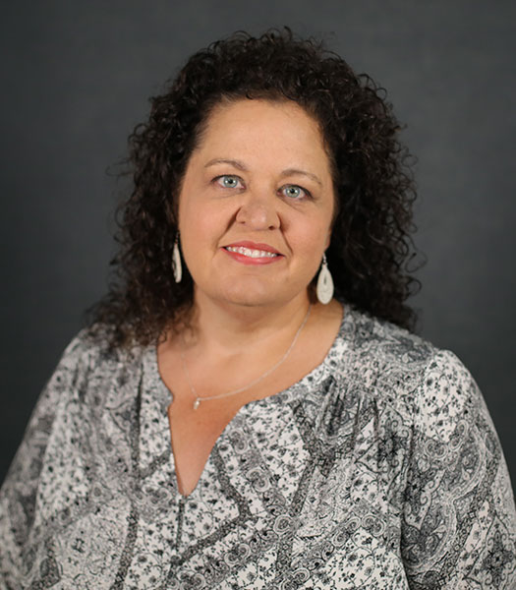
Suzanna Powell
Somerset Community College
Scholarship Coordinator
Bachelor of Science – Campbellsville University
Somerset Community College - @ 5 years
KASFAA Conference Committee – 2023- present

Slide 10
Scholarships as Recruiting Tool
Maintaining a presence in the High Schools is KEY!
SCC admissions applications days
KHEAA/FAFSA days
SCC Scholarship application days
Parent Nights
Senior Seminar Classes
Connection / Relationship with High School Counselors
College Fairs
Road Show events
Recruiting Scholarships
Academic Achievement is awarded to all students in SCC service area that graduate in the top 10% of their class.
MSSE Grant Scholarship – Pell Eligible students who plan to transfer to a 4 year in a MSSE field.
KCTCS Presidential – Merit based - Current year High School Graduates
Commonwealth – Merit based - Current year High School Graduates
Rogers/Governor Scholars – Program Completion - Current year High School Graduates
Campus Involvement Scholarships – SGA, Ambassadors, Honors Program

Slide 11
SCC Scholarship Process (Advancement side)
  Advancement Office Receives Check/Pledge
  Deposit into College or Foundation based on the Donors wishes
  Send thank you letter and tax receipt if applicable to donor
  Process the new gift (gift process form , entries , etc..)
  Enter Scholarship into BAM (Blackbaud Award Management)
  Notify Scholarship Office of the new opportunity, the restrictions, and how many awards to be made
  Send thank you letters from recipients to donors
SCC Scholarship Process (Financial Aid side)
  Scholarship Review Committee – 20-25 Staff/Faculty members
    Reviews and scores applications based on KCTCS Rubric
  Scholarship Coordinator
    Selects based on Award Criteria in BAM
    All Student Communication
    Updates Student Accounts
    Maintains documentation

Slide 12
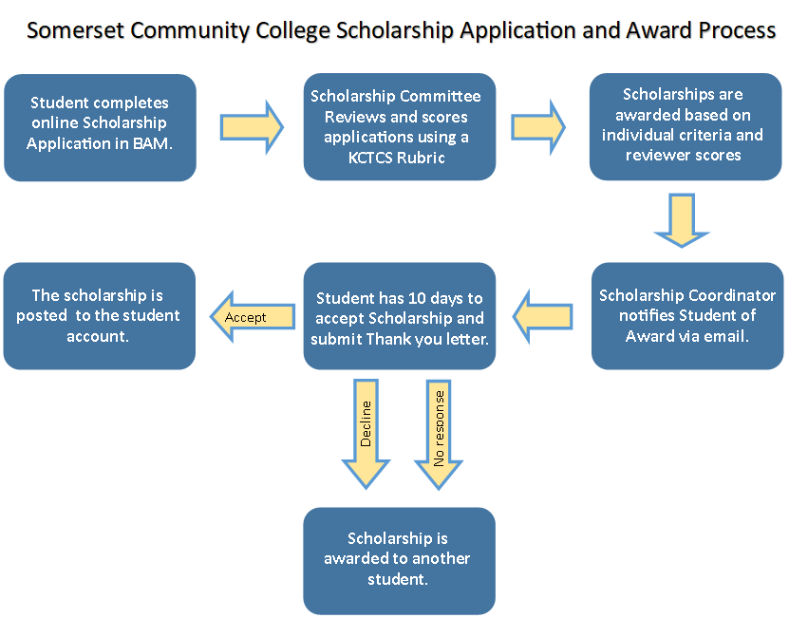

Slide 13
Institutional Methodology
“Financial Need” – We start with a range of SAI that tries to identify the “Middle of the road” students.

Slide 14

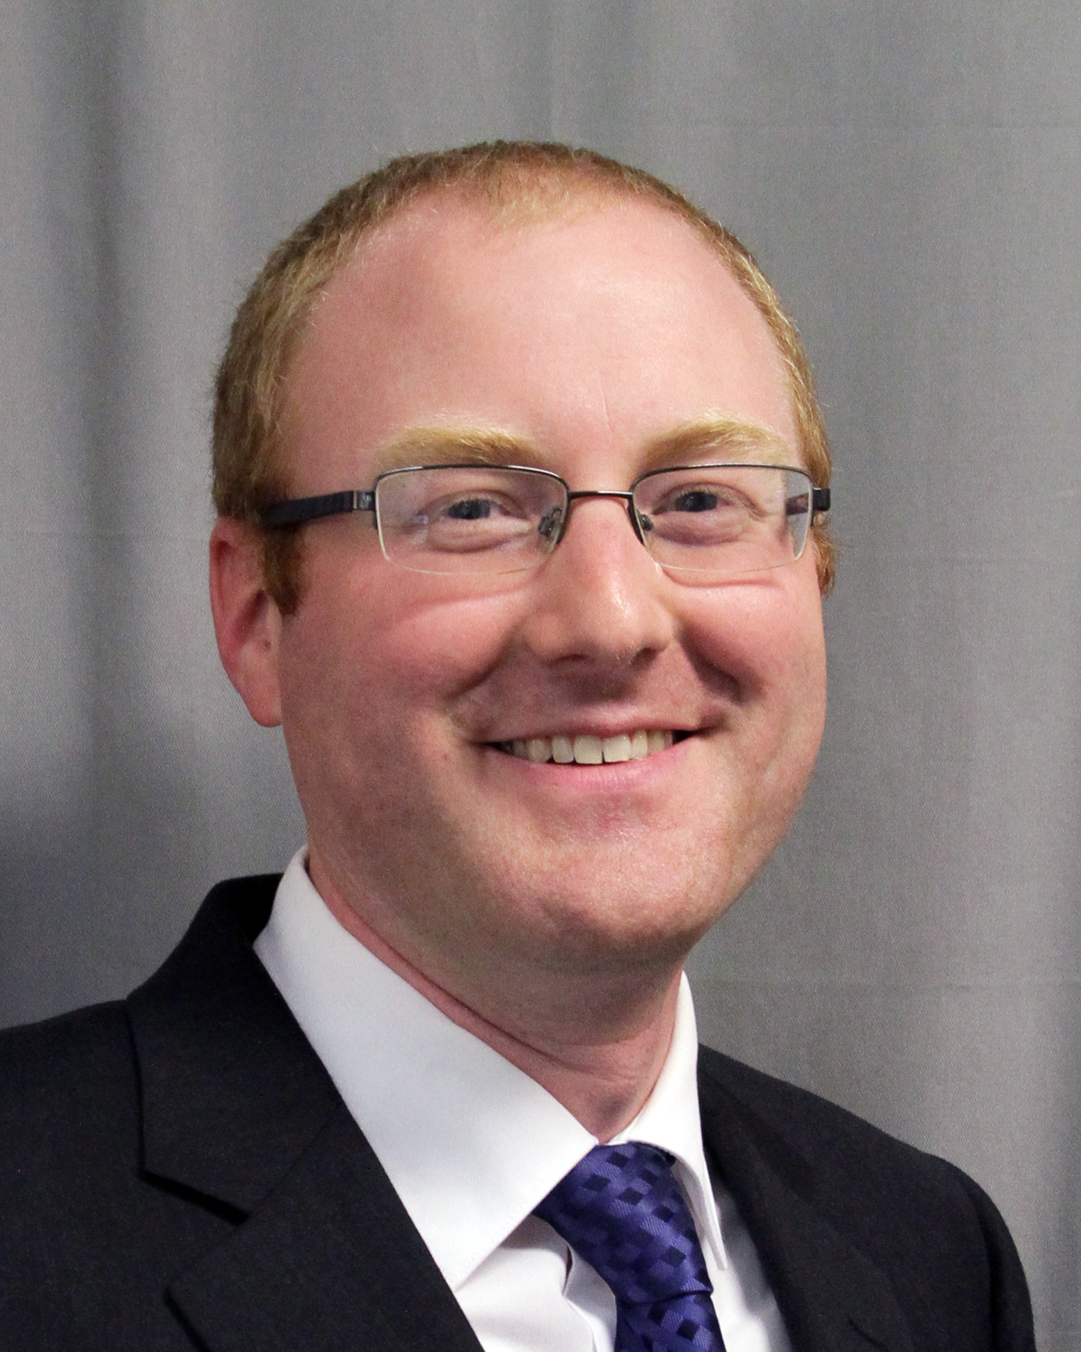
Thomas More University
Mark Messingschlager
Assistant Vice President of Admissions and Financial Aid
$20,000,000 scholarship endowment
  $1,000,000 funded scholarships awarded annually
  125 scholarships

Slide 15
New Scholarships
Donation made to the university.
Advancement office drafts scholarship agreement
  Sends to Financial Aid for review before signature
After one year, first scholarship awarded

Slide 16
Awarding
All endowments are awarded through the Financial Aid Office
Other offices are involved in some aspects.
  Admissions collects applications, essays, and letters of recommendations for first year scholarships.
  Faculty committees make recommendations to Financial Aid for major-specific scholarships.
  Advising office makes recommendations for retention purposes.

Slide 17
Financial Need
Many scholarships list need as a criteria.
Thomas More does not use IM to award any scholarships; just FM
No guarantees of meeting need

Slide 18
Recruitment
Admissions awards leveraging aid
One of the scholarships is quasi-discount
We replace (underwrite) with funded endowments later for specific populations.
  Lowers institutional discount rate without having to commit specific scholarships up front.

Slide 19
Retention
Some scholarships with no living donors and open restrictions are saved for retention purposes.
These are used to help replace lost Pell, CAP, and KTG from prior years
These help with 5th year seniors
Unexpected financial situations
Advising office is a crucial partnership

Slide 20
Outsourcing
Thomas More does not outsource any part of the process.
Goal is to develop in-house app to handle some of the administrative functions
  Dashboard of all scholarships to include
  Criteria
  Amount available
  Current recipients
  Queries to find currently eligible students based on criteria

Slide 21

Questions?

